Slide 1
Facilitator Guide
Deliver Modes
Version 0.1
Last modified by Mike Burns 2022-05-18

Slide 2
Contents
Facilitators Guide to Running a Delivery Mode
Overview
Process
Outputs
Supporting Tools & Techniques

Slide 3
Overview

Slide 4
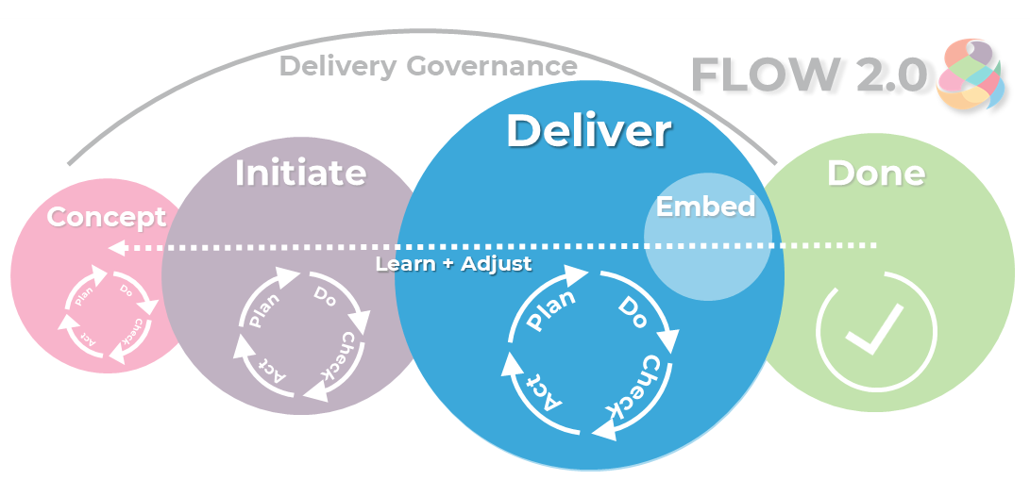
Overview
To understand the work to be done including the business rules or business logic and functional decomposition.
Define, prioritise and plan the work units
Understand and plan the tech stack, the work environment – including Dev/Test environments
Make a ‘go/no go’ decision

Slide 5
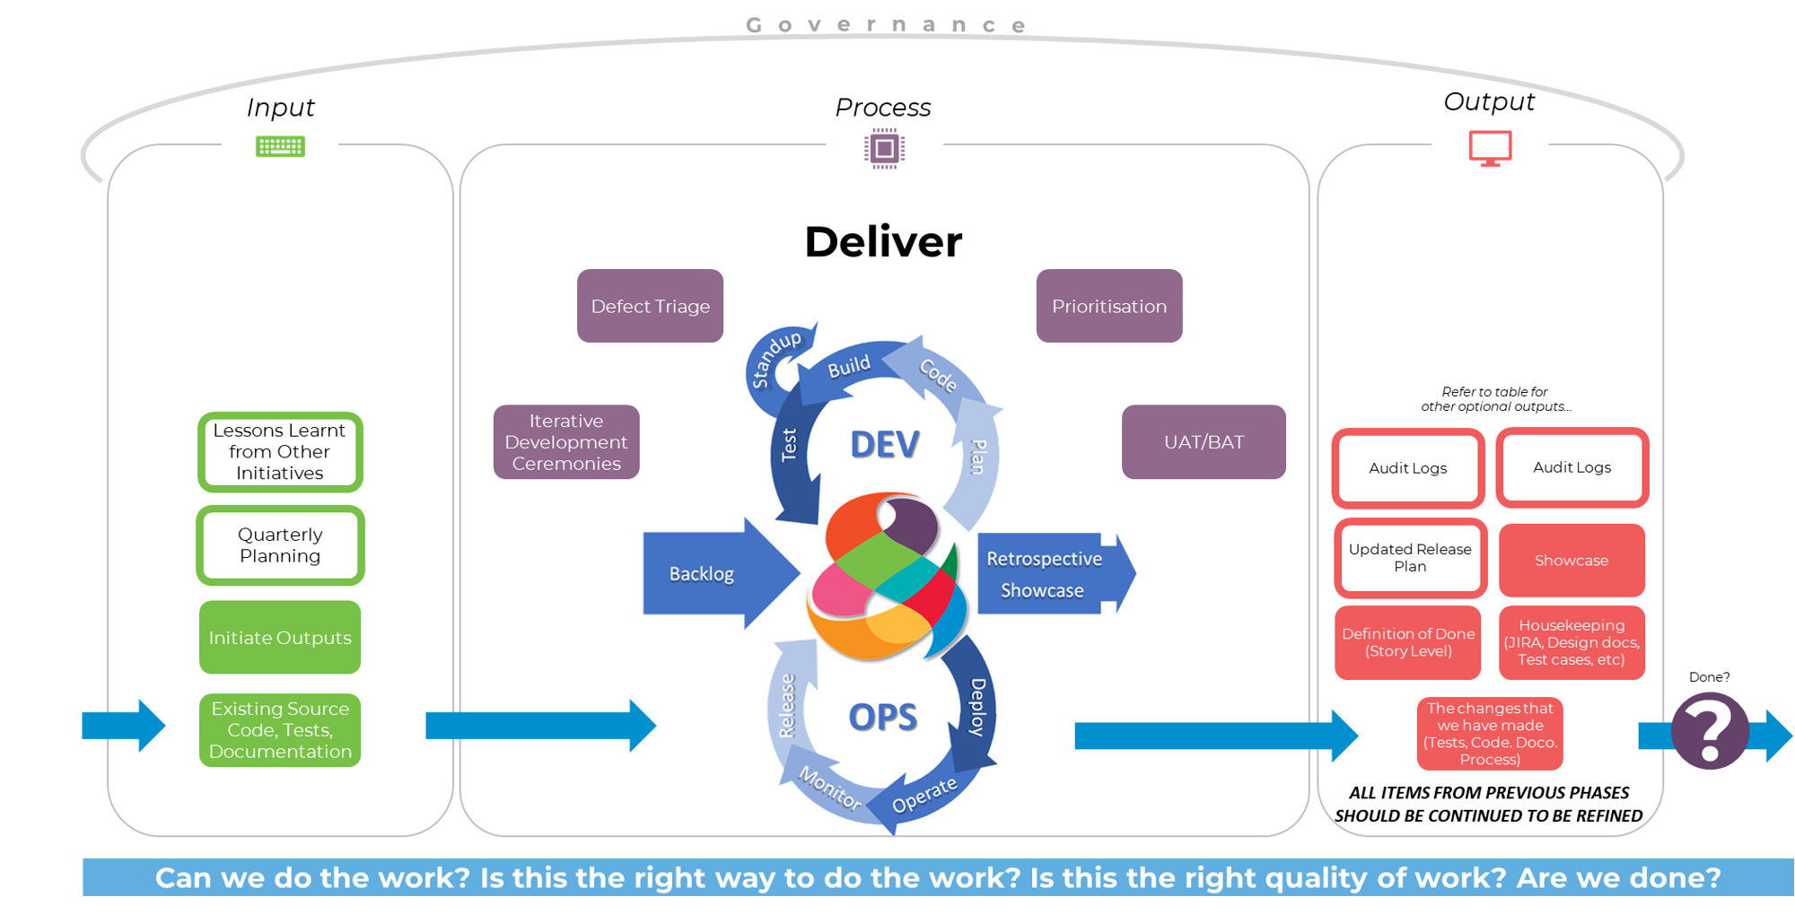

Slide 6
Can we do the Work?
The ‘deliver phase’ is about turning the work identified into reality – providing a tangible solution.
This is where the discovery of the actual activities and tasks that are required to deliver the solution is identified and added to the plan for delivery.
This phase focuses on the delivery teams, environments, tools, processes and techniques that need to be in place for successful delivery.
This is broken into short, sharp delivery units (iterations) so that progress, quality and other key attributes can be regularly assessed by key stakeholders.
In the ‘Deliver Phase’, there will need to be a change within the CIM system for production.
Create the work iteratively
The delivery phase is where the team, environment, tools, process, techniques and handoff points are established – this is done as part of Iteration Zero (I0).
Each iteration focuses on the delivery of value but also contains iteration level activities to allow the team to be clear on structure and approach.
The aim is to finish small units of work to provide items for feedback to the key stakeholders.
Set up the work environments
Plan a cycle of work
complete a cycle of work
Evaluate the cycle of work against success criteria
Understand the learnings from the cycle of work
Assess what needs to change in work identification, planning or creation processes and steps
Identify next steps to take
When “enough” work has been planned to provide information to the management teams

Slide 7
Process
Delivery team/s will be engaged more in the detail of the change, and will elaborate and break up work into right-sized chunks.

Slide 8
Steps
Iterative Development Ceremonies (Showcase, Retros, Stand-ups, Sprint Planning, Backlog Maintenance)
Defect Triage
Prioritisation
UAT/BAT

Slide 9
Who is involved?
Project Manager
Product Manager
Scrum Master
Team members
Key stakeholders
Trusted Advisors:
Change Manager
Configuration Item Manager
Solution Architects

Slide 10
Approach
Solutions are beyond software. All software development has to be supported by people and processes, as well as the relevant infrastructure and technology.
The solution delivery should look beyond the defined software requirements to ensure that the software being developed is in alignment with the business strategies, goals and processes.
Solutions typically encompass many dimensions of an organisation.
End to End teams work through applying the change/s, with a continuous plan-do-check-act cycle.
Change management activities are undertaken during delivery to ensure the impacted parties and interested stakeholders are aware and prepared for the change when it is deployed.

Slide 11
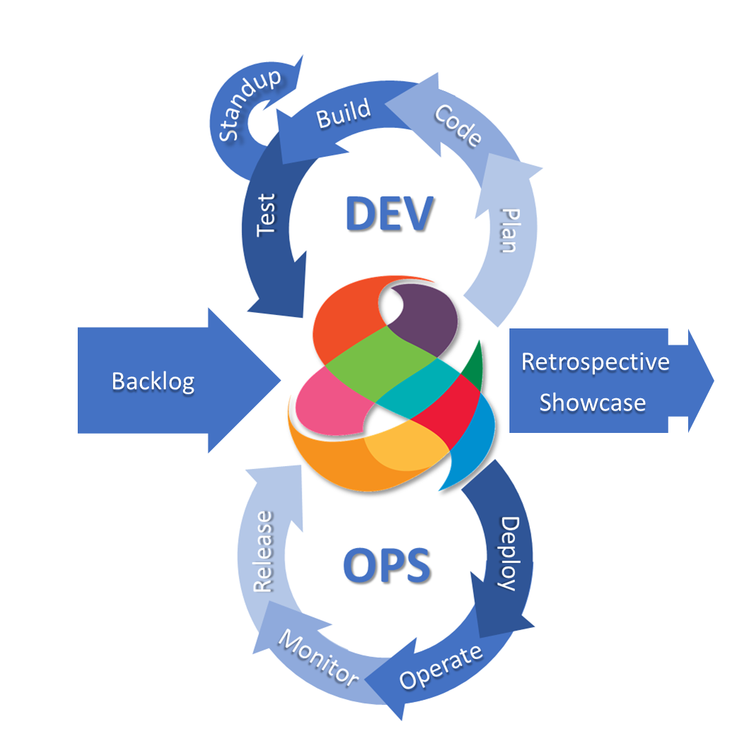
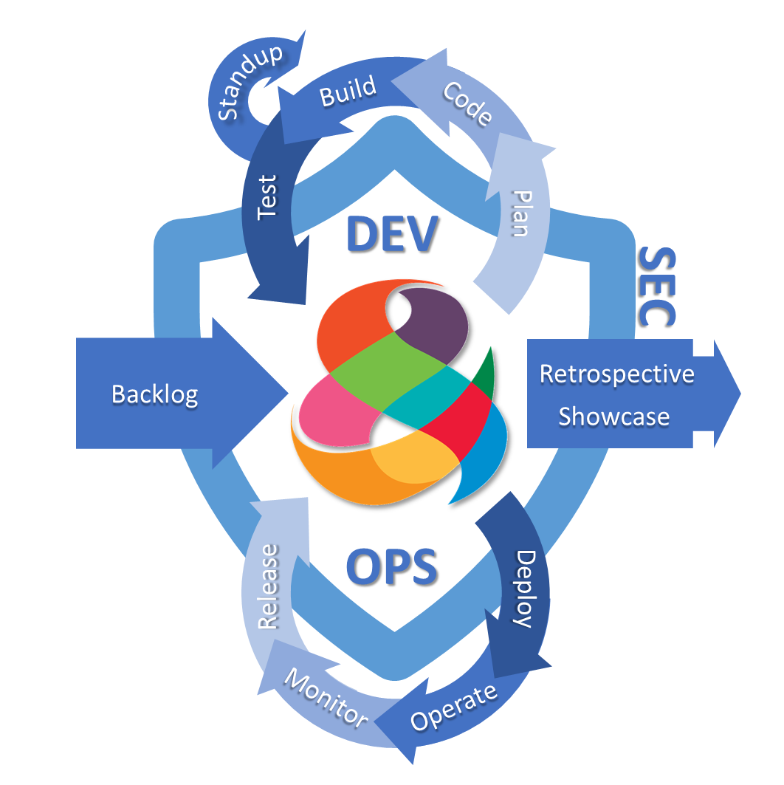
DevOps
Eventually
DevSecOps…

Slide 12
Activities
Establish the development and Continuous Integration and Continuous deployment environments and tools
Define standards and practices for Dev and Test
Formalise and ratify the cross-team(s) communication approach including remote and dependent teams
Take the highest priority activities and plan when they will be achieved within the iteration length
Take the candidate’s work items through elaboration sessions to clarify and understand all work needed
As a team complete the work activities in accordance with team level patterns and practices (source control, design patterns, test case management, feedback loops, reporting activities)
Plan the iteration a– mandatory activities and planned work for the iteration
Allocate owners, roles and responsibility for each unit of work
Collaborate often and well
Coordinate activities on a daily basis
Focus on getting activity done before commencing another one
As each activity is completed obtain meaningful feedback on quality and acceptability
As each iteration is completed obtain feedback on how the process allowed maximum workflow
Aim to identify and eliminate any areas of “waste” or hindrance
Escalate any issues that the team cannot solve internally

Slide 13
Questions
How can break the goal into smaller pieces of work that still provide some benefit?
Who is the work for?
What do they get from it?
How can break the goal into smaller pieces of work that still provide some benefit?
Who is the work for?
What do they get from it?
How can break the goal into smaller pieces of work that still provide some benefit?
Who is the work for?
What do they get from it?

Slide 14
Important!
All Concept & Initiate activities and tools should be considered again for Deliver

Slide 15
Outputs

Slide 16
Deliverables
Simple Change (Must)
Changes made to Tests, Code, Doco, etc.
Solution Design
Definition of Done (Story Level)
Showcase
Complex Change (Should/Could)
Note: All 'Simple Change' outputs plus a selection of:
Release Plan (Updated)
Audit Logs
Security Assessment
Note: ALL ITEMS FROM INITIATE SHOULD BE CONTINUED TO BE REFINED. ALL DOCUMENTATION IS 'LIVING'.

Slide 17
Supporting Tools and Techniques
Examples of tools and techniques to support you during the Initiate workshop, and throughout Initiate phase.

Slide 18
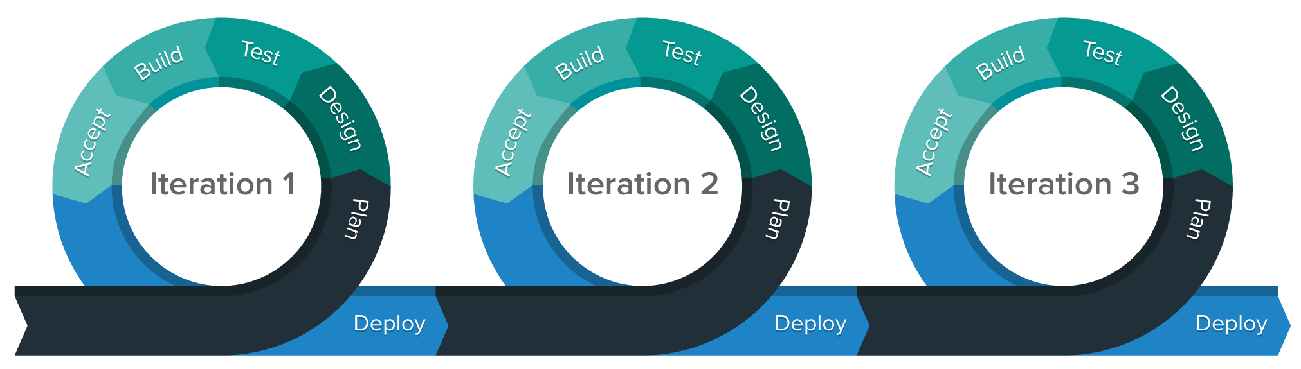
Tools – Kick-Off / Iteration 0
A kick-off ceremony is great for new teams to signal the start of the newly formed team.
Activities
Social Contract
Setting up team calendar
Iteration 0 activities can usually be part of the initiate mode. Iteration zero should only be required for brand new teams where the environment and ceremony cadence are not yet in place.
Activities
Backlog updated
Sprint planning session ensues
Daily Sprint team meetings
Sprint review sessions or debrief
Deliverable product
Sprint retrospective
Iteration 0
Iteration 1
Iteration 2
Kick-Off

Slide 19
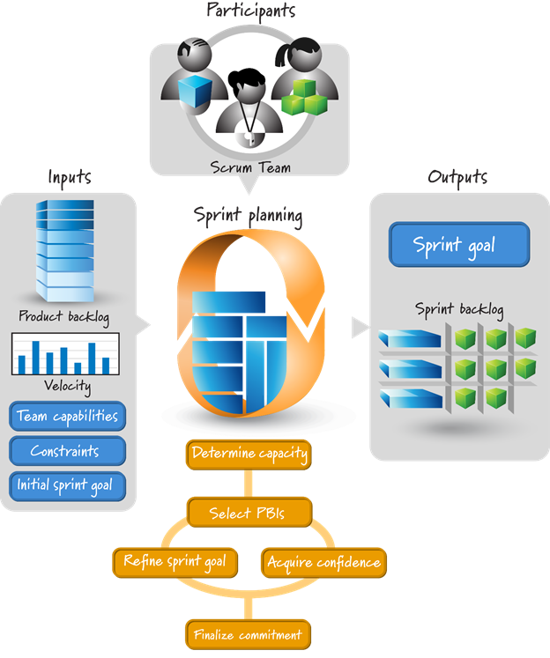
Tools – Iteration planning
Sprint Planning is the first action in the sprint and sets it up for success.
The whole Scrum team, plus relevant stakeholders and SMEs, should collaborate in this ceremony.

Slide 20
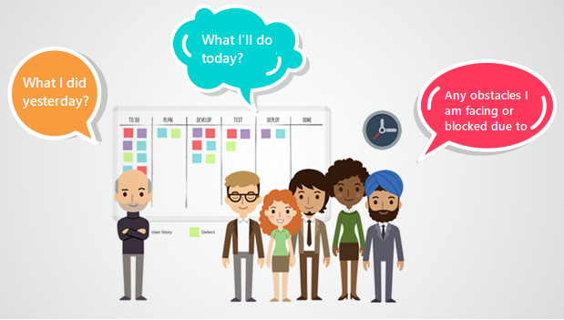
Tools – Daily stand-up
A stand-up is generally a short time-boxed 15-minute session where all members of the squad either stand or virtually get together and set the context for the coming day’s work.
The Scrum Master is usually the facilitator of this ceremony, but the stand-up can successfully be facilitated by any team member.
The primary goal is to identify areas where the squad may be blocked or impeded and to plan for the upcoming day.
This is often done in front of a visual or virtual wall that displays the squad’s work in the form of user stories.
The daily stand-up consists of each squad member answering three questions:
What did I do yesterday?
What am I doing today?
What impediments or blockers are in my way?
Note: Usually, only the squad attends but it should be open to stakeholders that are curious to know more about the project’s progress.

Slide 21
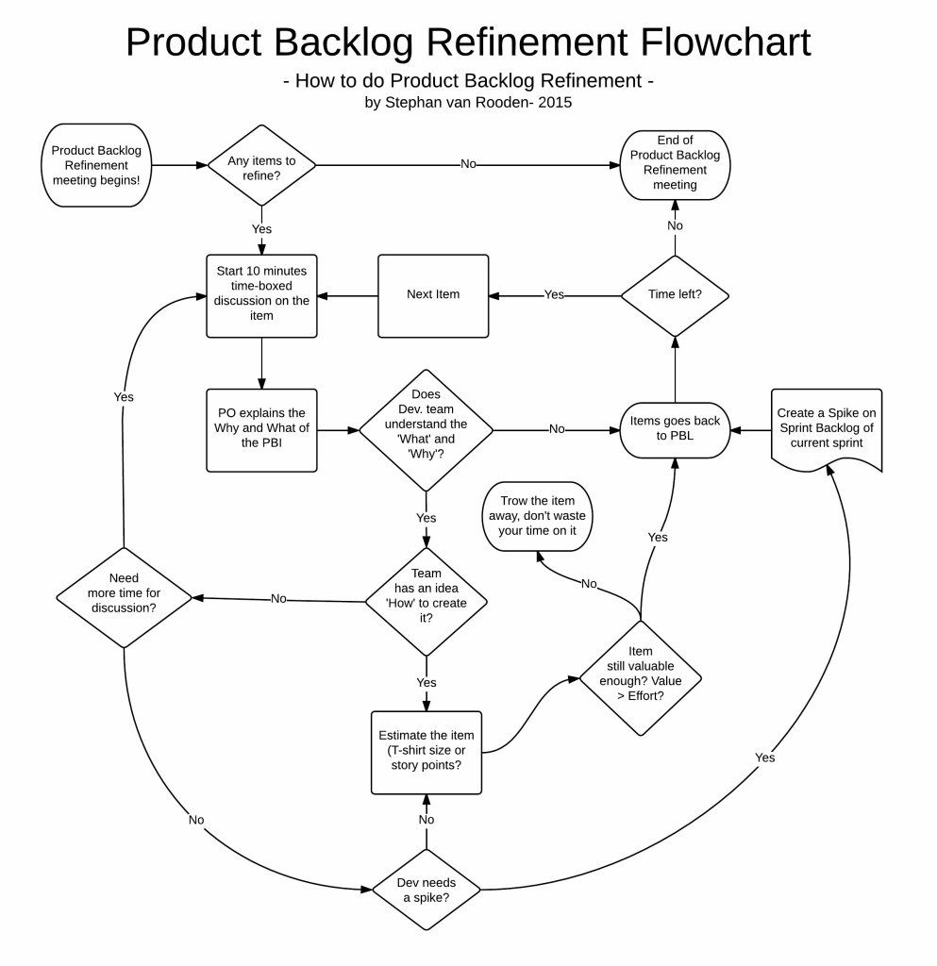
Tools – Elaboration sessions
Whole team to have an aligned understanding and intent behind each feature/function (broken up into Stories) that is to be implemented.
Fundamentally create a shared understanding of each Story across the team in order to draw on the collective mindset, and transfer knowledge across the team.

Slide 22
Tools – CI/Deployment toolsets

Slide 23
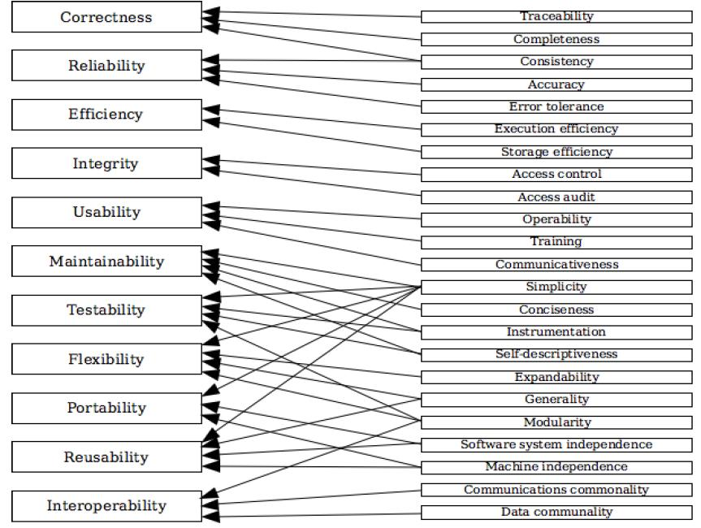
Tools – Quality models
Understanding what you will base your quality on and getting everyone to agree is not easy.
Having a model to work from helps determine the areas that you will focus on.
Not every solution has to have 100% in each of these “ilities” – a proof of concept or something that needs to get to market really quickly may not need to focus on maintainability (at first), but a legacy system might. However, the legacy system may not require high usability as it is a green-screen system, but the new mobile app requires a great deal of usability.
https://en.wikipedia.org/wiki/List_of_system_quality_attributes

Slide 24
Tools – Plan
This phase helps define business values and requirements. Sample tools include Jira or Git to help track known issues and perform work management.
Activities include:
Production metrics, objects and feedback
Requirements
Business metrics
Update release metrics
Release plan, timing and business case
Security policy and requirement
A combination of the IT personnel will be involved in these activities: business application owners, software development, software architects, continual release management, security officers and the organization responsible for managing the production of IT infrastructure.
The Plan stage covers everything that happens before the developers start writing code.
Requirements and feedback are gathered from stakeholders and customers and used to build a product roadmap to guide future development. The product roadmap can be recorded and tracked using a ticket management system such as Jira which provides a variety of tools that help track project progress, issues and milestones.
The product roadmap can be broken down into Epics and User Stories, creating a backlog of tasks that lead directly to the customers’ requirements. The tasks on the backlog can then be used to plan sprints and allocate tasks to the team to begin development.

Slide 25
Tools – Code
This phase involves the design and the creation of code. Sample tools include GitHub, GitLab, Bitbucket, or Stash.
Create is composed of the building, coding, and configuring of the software development process. The specific activities are:
Design of the software and configuration
Coding including code quality and performance
Software build and build performance
Release candidate
Tools and vendors in this category often overlap with other categories. Because DevOps is about breaking down silos, this is reflective of the activities and product solutions.
Once the team had grabbed their coffees and had the morning stand-up, the developments can get to work. In addition to the standard toolkit of a software developer, the team has a standard set of plugins installed in their development environments to aid the development process, help enforce consistent code-styling and avoid common security flaws and code anti-patterns.
This helps to teach developers good coding practice while aiding collaboration by providing some consistency to the codebase. These tools also help resolve issues that may fail tests later in the pipeline, resulting in fewer failed builds.

Slide 26
Tools – Build
In this phase, you manage software builds and versions, and use automated tools to help compile and package code for future release to production.
You use source code repositories or package repositories that also “package” infrastructure needed for product release. Sample tools include Docker, Ansible, Puppet, Chef, Gradle, Maven, or JFrog Artifactory.
The Build phase is where DevOps really kicks in. Once a developer has finished a task, they commit their code to a shared code repository. There are many ways this can be done, but typically the developer submits a pull request — a request to merge their new code with the shared codebase. Another developer then reviews the changes they’ve made, and once they’re happy there are no issues, they approve the pull request. This manual review is supposed to be quick and lightweight, but it’s effective at identifying issues early.
Simultaneously, the pull request triggers an automated process that builds the codebase and runs a series of end-to-end, integration and unit tests to identify any regressions. If the build fails, or any of the tests fail, the pull-request fails and the developer is notified to resolve the issue. By continuously checking code changes into a shared repository and running builds and tests, we can minimise integration issues that arise when working on a shared codebase, and highlight breaking bugs early in the development lifecycle.

Slide 27
Tools – Test
This phase involves continuous testing (manual or automated) to ensure optimal code quality. Sample tools include JUnit, Codeception, Selenium, Vagrant, TestNG, or BlazeMeter.
Once a build succeeds, it is automatically deployed to a staging environment for deeper, out-of-band testing. The staging environment may be an existing hosting service, or it could be a new environment provisioned as part of the deployment process. This practice of automatically provisioning a new environment at the time of deployment is referred to as Infrastructure-as-Code (IaC) and is a core part of many DevOps pipelines. More on that in a later article.
Once the application is deployed to the test environment, a series of manual and automated tests are performed. Manual testing can be traditional User Acceptance Testing (UAT) where people use the application as the customer would to highlight any issues or refinements that should be addressed before deploying into production.
At the same time, automated tests might run security scanning against the application, check for changes to the infrastructure and compliance with hardening best-practices, test the performance of the application or run load testing. The testing that is performed during this phase is up to the organisation and what is relevant to the application, but this stage can be considered a test-bed that lets you plug in new testing without interrupting the flow of developers or impacting the production environment.

Slide 28
Tools – Deploy
This phase can include tools that help manage, coordinate, schedule, and automate product releases into production. Sample tools include Puppet, Chef, Ansible, Jenkins, Kubernetes, OpenShift, OpenStack, Docker, or Jira.
Finally, a build is ready for the big time and it is released into production. There are several tools and processes that can automate the release process to make releases reliable with no outage window.
The same Infrastructure-as-Code that built the test environment can be configured to build the production environment. We already know that the test environment was built successfully, so we can rest assured that the production release will go off without a hitch.
A blue-green deployment lets us switch to the new production environment with no outage. Then the new environment is built, it sits alongside the existing production environment. When the new environment is ready, the hosting service points all new requests to the new environment. If at any point, an issue is found with the new build, you can simply tell the hosting service to point requests back to the old environment while you come up with a fix.

Slide 29
Tools – Operate
This phase manages software during production. Sample tools include Ansible, Puppet, PowerShell, Chef, Salt, or Otter.
The new release is now live and being used by the customers. Great work!
The operations team is now hard at work, making sure that everything is running smoothly. Based on the configuration of the hosting service, the environment automatically scales with load to handle peaks and troughs in the number of active users.
The organisation has also built a way for their customers to provide feedback on their service, as well as tooling that helps collect and triage this feedback to help shape the future development of the product. This feedback loop is important — nobody knows what they want more than the customer, and the customer is the world’s best testing team, donating many more hours to testing the application than the DevOps pipeline ever could. You need to capture this information, it’s worth its weight in gold.

Slide 30
Tools – Monitor
This phase involves identifying and collecting information about issues from a specific software release in production. Sample tools include New Relic, Datadog, Grafana, Wireshark, Splunk, Nagios, or Slack.
The ‘final’ phase of the DevOps cycle is to monitor the environment. this builds on the customer feedback provided in the Operate phase by collecting data and providing analytics on customer behaviour, performance, errors and more.
We can also do some introspection and monitor the DevOps pipeline itself, monitoring for potential bottlenecks in the pipeline which are causing frustration or impacting the productivity of the development and operations teams.
All of this information is then fed back to the Product Manager and the development team to close the loop on the process. It would be easy to say this is where the loop starts again, but the reality is that this process is continuous. There is no start or end, just the continuous evolution of a product throughout its lifespan, which only ends when people move on or don’t need it anymore.

Slide 31
Tools – Release
Release related activities include scheduling, orchestration, provisioning and deploying software into production and targeted environment. The specific Release activities include:
Release coordination
Deploying and promoting applications
Fallbacks and recovery
Scheduled/timed releases
Solutions that cover this aspect of the toolchain include application release automation, deployment automation and release management.
The Release phase is a milestone in a DevOps pipeline — it’s the point at which we say a build is ready for deployment into the production environment. By this stage, each code change has passed a series of manual and automated tests, and the operations team can be confident that breaking issues and regressions are unlikely.
Depending on the DevOps maturity of an organisation, they may choose to automatically deploy any build that makes it to this stage of the pipeline. Developers can use feature flags to turn off new features so they can’t be seen by the customers until they are ready for action. This model is considered the nirvana of DevOps and is how organisations manage to deploy multiple releases of their products every day.
Alternatively, an organisation may want to have control over when builds are released to production. They may want to have a regular release schedule or only release new features once a milestone is met. You can add a manual approval process at the release stage which only allows certain people within an organisation to authorise a release into production.
The tooling lets you customise this, it’s up to you how you want to go about things.

Slide 32
Tools – Showcase

Slide 33
Tools – Retrospective

